Slide 1
K.RAMAKRISHNAN COLLEGE OF TECHNOLOGY , DEPT OF CSE – B.E – [ 2021- 2025 ] Batch
20CS5501 DESIGN PROJECT- 1
Date & Session : 23.12.2023 & AN
Batch Number : 06
1

Slide 2
VIRTURAL ASSISTANCE USING PYTHON
Name of the Candidates : MUKUNTHAN S
Register Number : 811721104070
Name of the Candidates : SARATHY P
Register Number : 811721104090
Name of the Candidates : VIJAYAKUMAR S
Register Number : 811721104123
Name of the Supervisor : Mrs.S.Gayathiri
with Designation
2
Notes:
2

Slide 3
Objectives of the Project
The main aim of developing a virtual assistant using Python is to build a sophisticated computer program that can understand human language and interact with users naturally. By utilizing Python's capabilities, the goal is to incorporate advanced language processing techniques, like Natural Language Processing (NLP), allowing the assistant to comprehend and respond to spoken or written commands effectively. This assistant will offer an array of functionalities, such as fetching information, managing tasks, and aiding in communication tasks like sending messages or emails. Moreover, it's essential to maintain the system's reliability, security, and continuous enhancement through user feedback.
3

Slide 4
Abstract
The Virtual Assistance Using Python project stands as an innovative and multifaceted software solution, meticulously crafted to function as an intuitive and intelligent virtual assistant. Through harnessing the extensive capabilities inherent in the Python programming language and seamlessly integrating an array of pertinent libraries and APIs, this system is purpose-built to afford users an interactive and responsive platform.

Slide 5
Introduction
A versatile and powerful programming language, in conjunction with machine learning opens up a realm of possibilities for creating intelligent virtual assistants. These digital entities are designed to comprehend natural language inputs, recognize user intentions, and execute tasks seamlessly. Python's rich ecosystem, encompassing robust libraries for Natural Language Processing (NLP) and machine learning, provides an ideal foundation for developing responsive and adaptive virtual assistants.

Slide 6
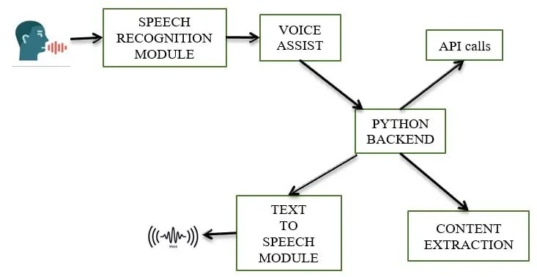
Existing System Architecture
6

Slide 7
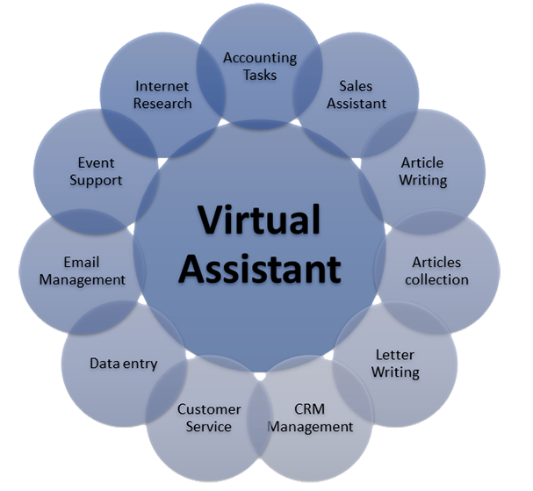
Existing System Architecture-Findings
7

Slide 8
Proposed System Architecture
User Interface (UI):
This component manages the interaction between users and the virtual assistant. It can include a graphical user interface (GUI), a command-line interface (CLI), or integration with messaging platforms.
Speech Recognition:
If supporting voice commands, this component converts spoken language into text using speech recognition libraries or services.
Natural Language Processing (NLP):
Handles text understanding through tasks like tokenization, part-of-speech tagging, entity recognition, sentiment analysis, and intent recognition using NLP libraries like NLTK, spaCy, or Transformers.
8

Slide 9
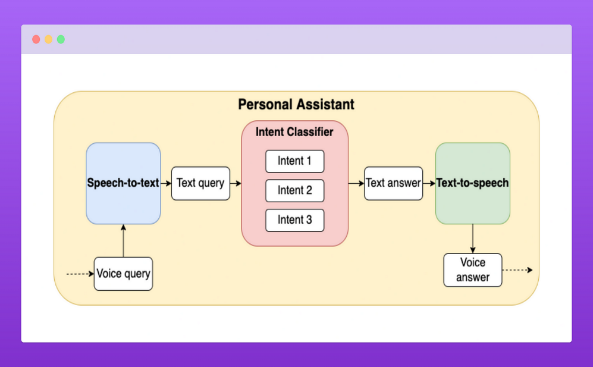
Proposed System Architecture
9

Slide 10
Software & Hardware Requirements Specification
SOFTWARES
PYTHON3
10

Slide 11
Software & Hardware Requirements Specification
HARDWARES
PC with 4-8GB RAM,128GB HDD or SSD.
11

Slide 12
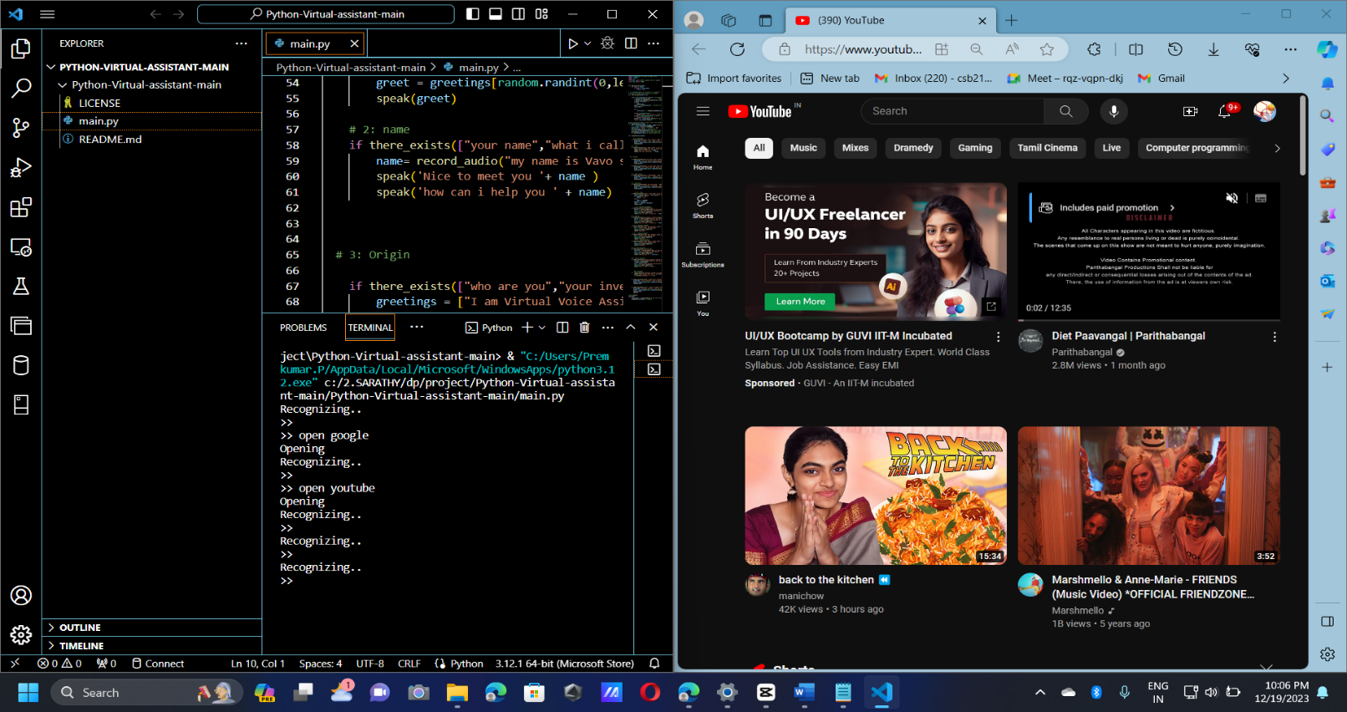
Partial Implementation of Output

Slide 13
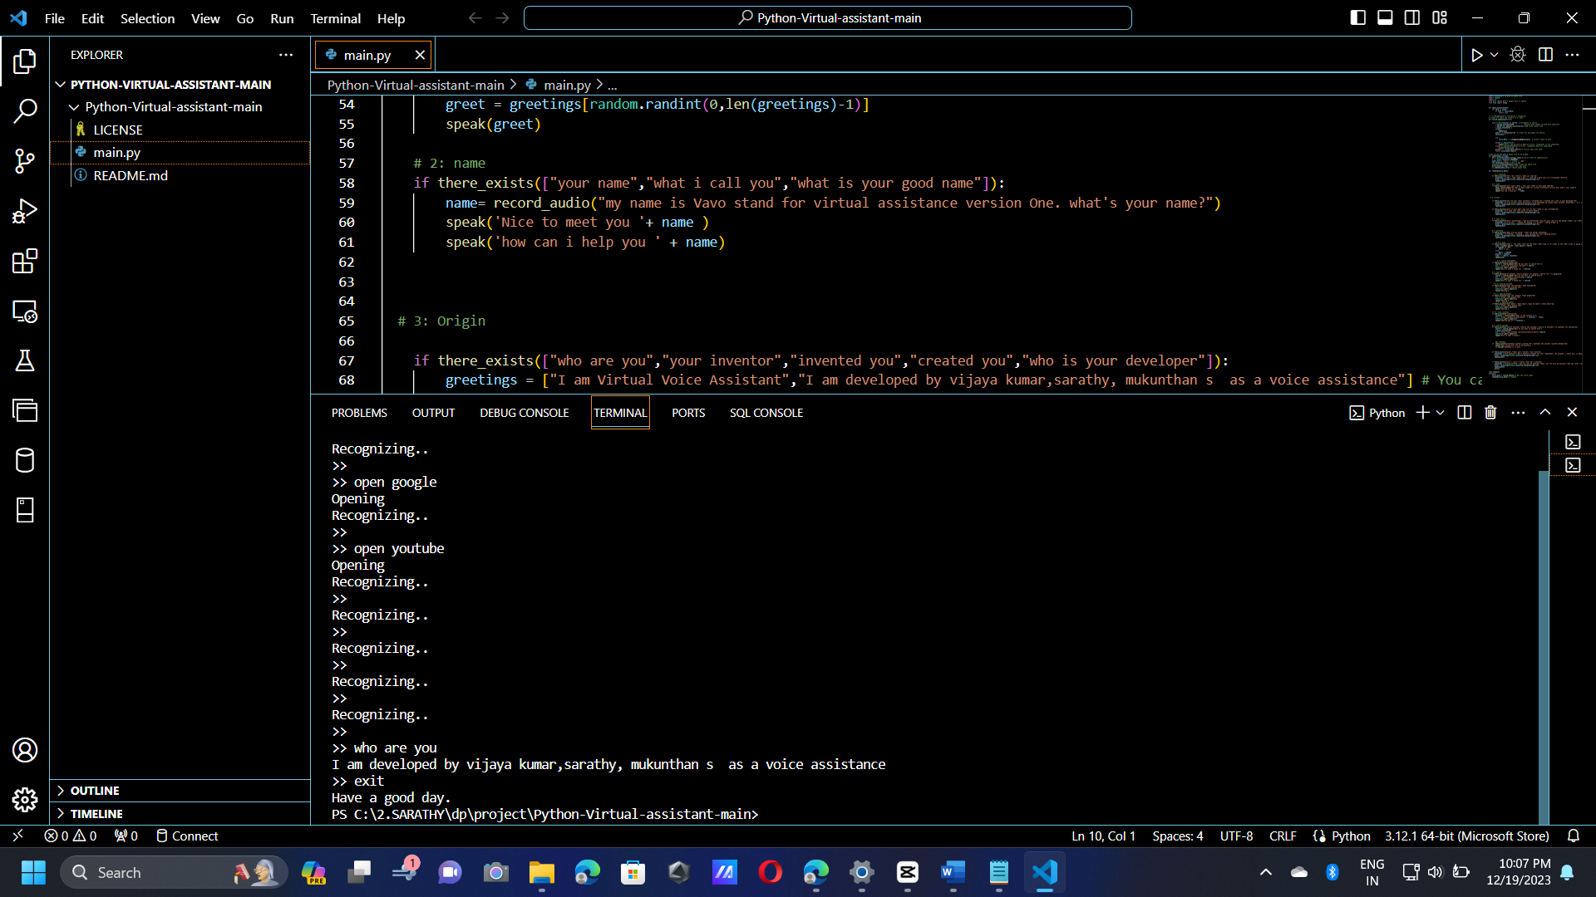
Partial Implementation of Output

Slide 14
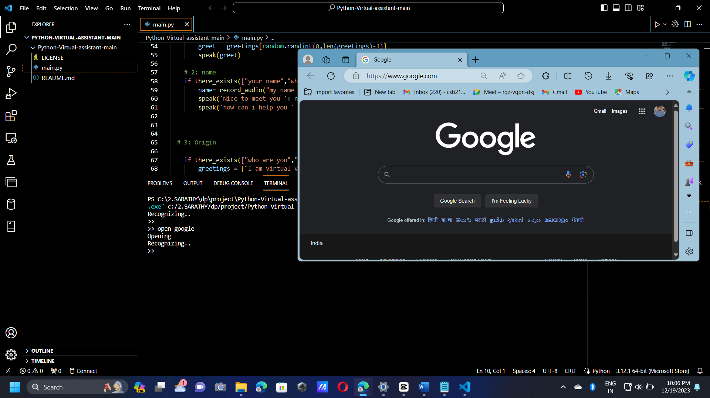
Partial Implementation of Output

Slide 15
CONCLUSION
In conclusion, the development of a virtual assistant using Python presents a dynamic and promising opportunity to create an AI-driven system that seamlessly interacts with users. By harnessing Python's robust capabilities and integrating various components such as Natural Language Processing (NLP), speech recognition, API integrations, and dialogue management, a sophisticated and versatile assistant can be constructed.As technology evolves, continuous advancements in machine learning, NLP, and AI will further enhance the capabilities of virtual assistants, enabling them to adapt, learn, and improve their performance over time. The field holds immense potential for innovation, offering opportunities to refine and expand the functionalities of virtual assistants, ultimately aiming to create more intuitive, intelligent, and user-friendly systems.

Slide 16
FUTURE ENHANCEMENT
1.Advanced Natural Language Understanding (NLU):
Enhance the assistant's NLU capabilities to understand complex user queries, contextual nuances, and varied languages or dialects.
2.Advanced Machine Learning Models:
Explore and integrate state-of-the-art machine learning models, such as transformer-based architectures (like GPT or BERT), to enhance language understanding and generation capabilities.

Slide 17
Any Queries
Thank you …
17

